Slide 1

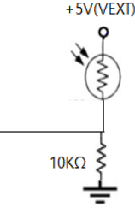

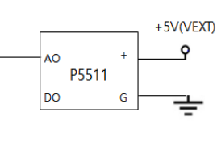


330Ω
PA 4
PA 5
PA 6
PA 7
(ADC0) PF 0
(ADC1) PF 1
(ADC2) PF 2
Data
Vcc
DHT22
BT PINS
RESERVED
GND
JMOD 128-1
(ATmega 128A)

